Slide 1

MAEER’S MIT POLYTECHNIC PUNE
College Address
MIT POLYTECHNIC, Paud Road, Kothrud, Pune
College Telephone Number
020 7117 7104
College Phone Number
020 7117 7104
College web site
https://mitwpu.edu.in/
Principal/Director’s Name, Email id, Contact Number
Principal Prof. Rohini Kale
Contact Number: 9890942780
Computer Science
Academic year 2022-2023

Slide 2





Sl. No | Name of Participant | Photo of Participant | Email id | Mobile Number
1 | Aryan Jadhav |  | aryjad364@gmail.com | 9607027905
2 | Varnan Dhondage |  | varnandhondage0246@gmail.com | 9307204168
3 | Ganraj Kendre |  | rajkendre439@gmail.com | 7666075097
4 | Soham Bhosage |  | sohambhosage24@gmail.com | 8600100443
Name of Head of the Department: Jyoti Khurpade
Email Id: jyoti.khurpade@gmail.com
Mobile Number: 8055270100
Computer Science
Academic year 2022-2023

Slide 3
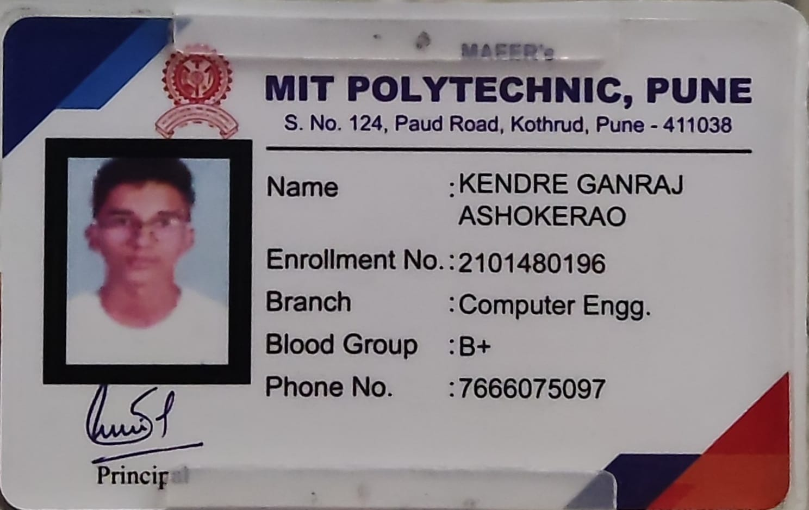
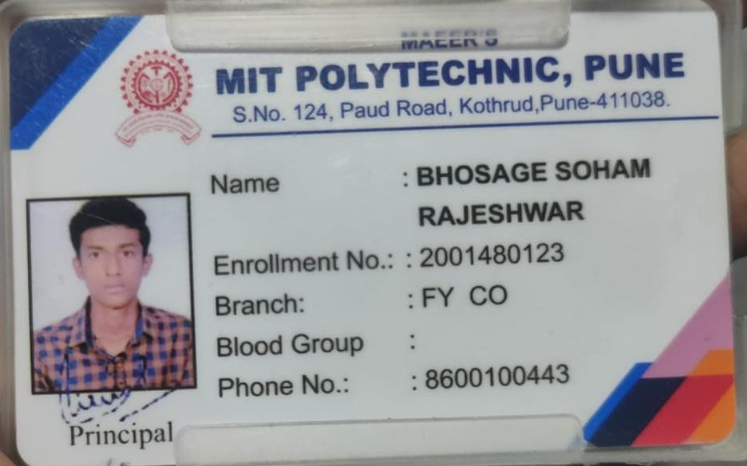
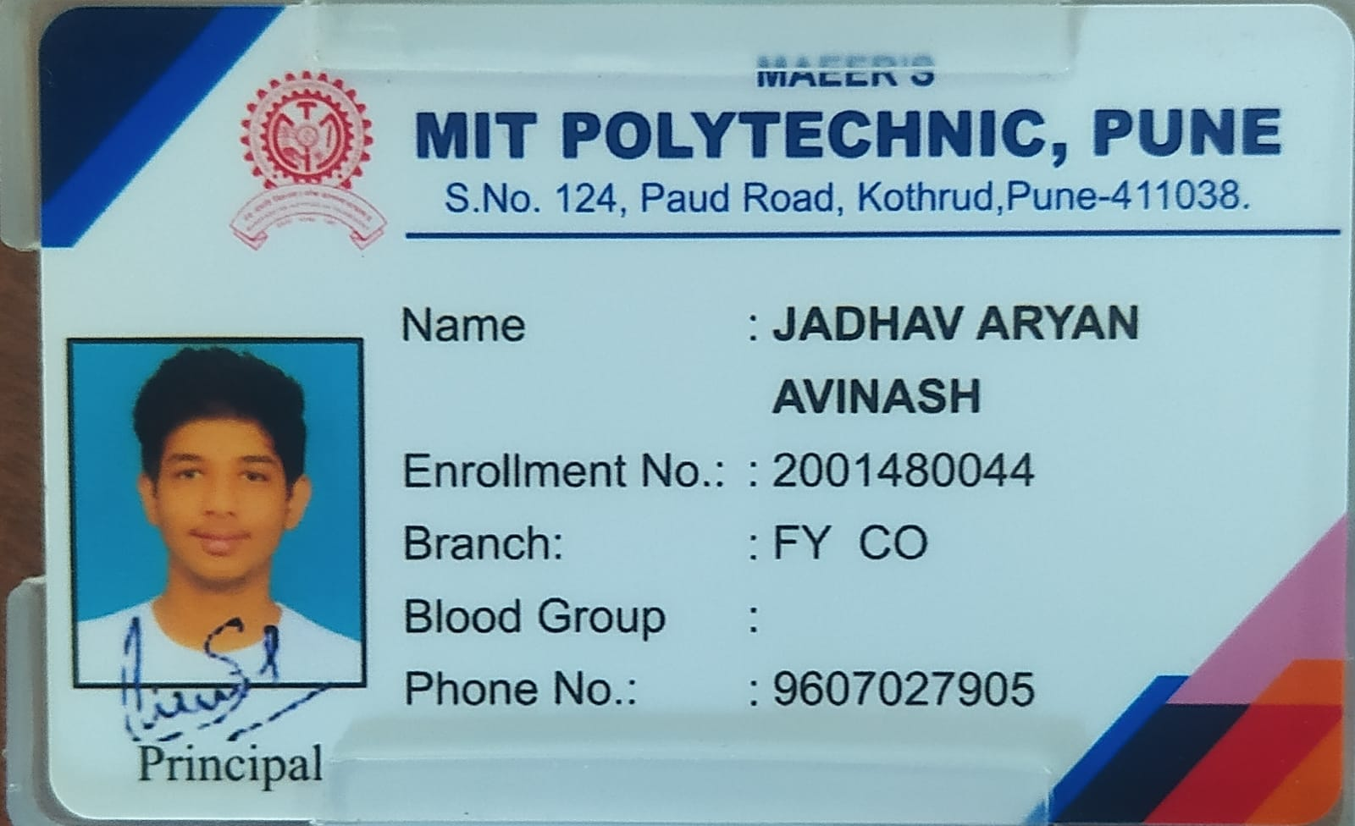
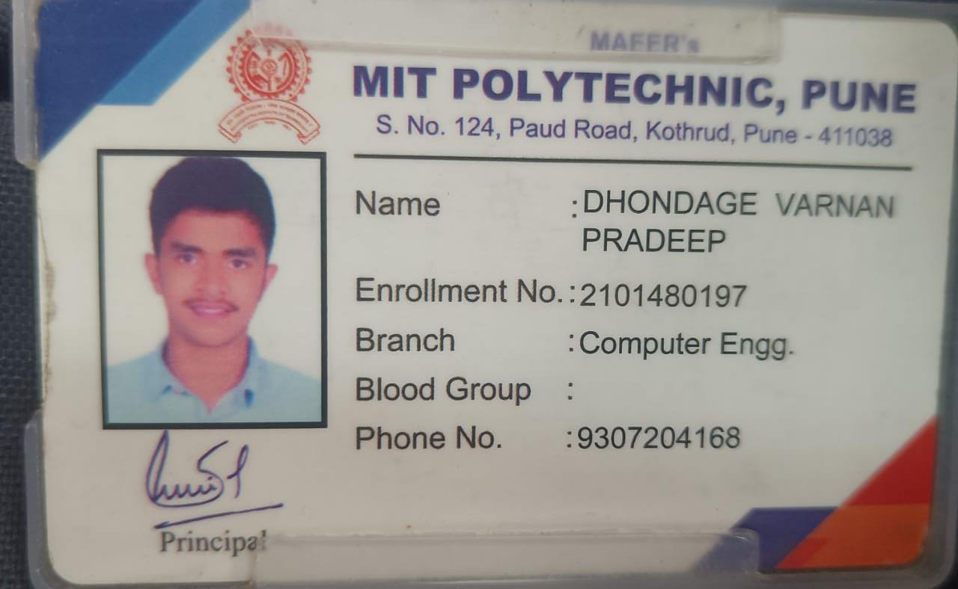
Department Name
Academic year 2022-2023

Slide 4
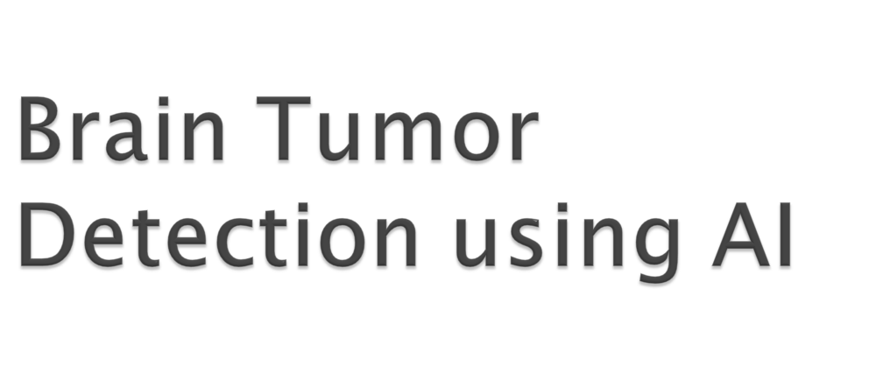
BY : Aryan Jadhav Varnan Dhondage
Ganraj Kendre Soham Bhosage

Slide 5
Contents
1. | Introduction
2. | Need of Project
3. | Problem definition
4. | Proposed methodology
5. | System Architecture
6. | Use Case Diagram
7. | Activity Diagram
Tumor Detection Using AI.

Slide 6
INTRODUCTION
Cancer is the leading cause of death in the world today
We have proposed a methodology to detect cancer using AI
This system will help the radiologists to detect cancer more reliably
In this system we analyse the data input by user and the system will give us a conclusion if the given tumor is malicious or benign.
In this methodology we have taken input from the users in the form of textual representations, these inputs then are further processed by the AI algorithms that we design to give a boolean output to the user, either if the cancer is malignant or benign
Tumor Detection Using AI.

Slide 7
Need of Project
AI can “see” things that we humans can’t, and can find complex patterns and relationships between very different kinds of data.
AI is be more reliable when it comes to identifying if a tumor is cancerous or non-cancerous.
This module will help radiologists with the identification of tumors, more accurately.
This module will also help the doctors, as AI can help to identify some specific features or symptoms of the tumor.
This will further help doctors to learn about Cancer.
Tumor Detection Using AI.

Slide 8
Problem Definition
Cancer is the leading cause of death in the world today
This disease is characterized by the development of abnormal cells that divide uncontrollably and the ability to infiltrate and destroy normal body tissue
There are estimated to be about 18.1 million cancer patients around the globe
One in Nine people are likely to develop cancer in their lifetime
Tumor Detection Using AI.

Slide 9
Proposed Methodology
We have taken input in the form of textual data so the data is in a structured format, this means we can use machine learning methods here, like supervised learning.
Supervised learning is a type of machine learning algorithm where a fixed output is given to the algorithm, and the AI finds the patterns in the data accordingly
The algorithm which is most suited for this circumstance is logistic regression, as we require discrete values here
We have to create a neural network to process the data.
Tumor Detection Using AI.

Slide 10
Proposed Methodology
The technique used for making this model work is Neural Network The different stages by which a Neural Network is applied to the dataset are:
Import the required packages
Import the data sets
Image reading is done after that it is labeled (such as 0 for benign and 1 for malicious) and then the reports are stored in the data frame.
The training sets are designed in a way that the AI algorithm learns from the training sets
The Accuracy of the System is evaluated
The loss graph and the accuracy graph are plotted.
Tumor Detection Using AI.

Slide 11
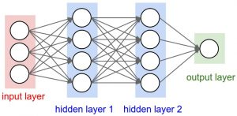
Neural Network Design
Tumor Detection Using AI.

Slide 12
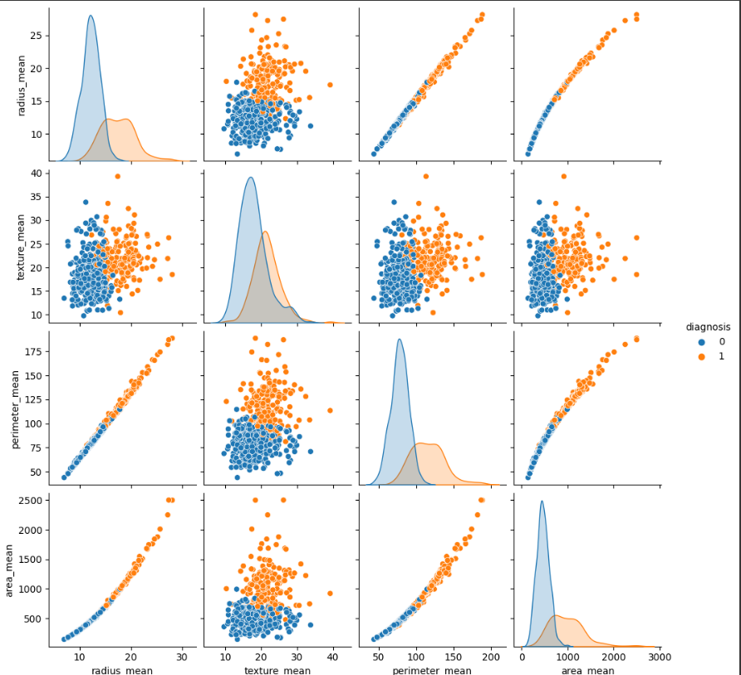
Pictorial Representation
Tumor Detection Using AI.

Slide 13
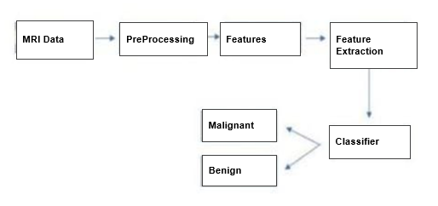
System Architecture
Tumor Detection Using AI.

Slide 14
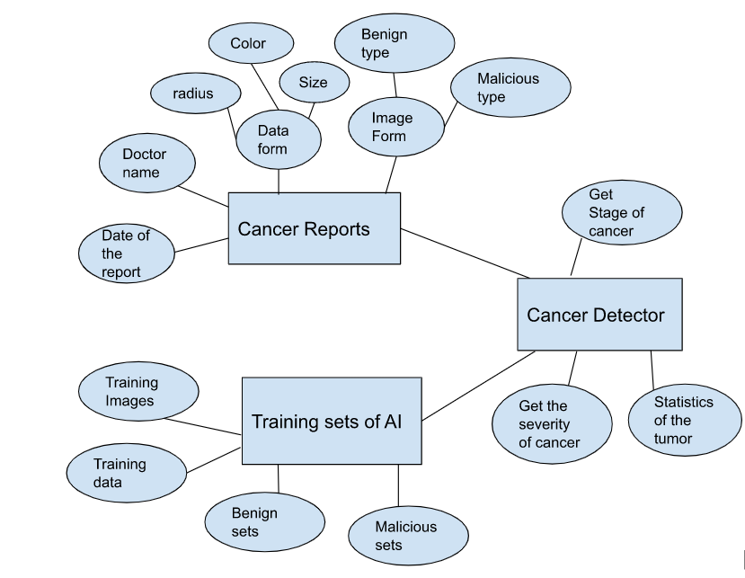
ER Diagram
Tumor Detection Using AI.

Slide 15
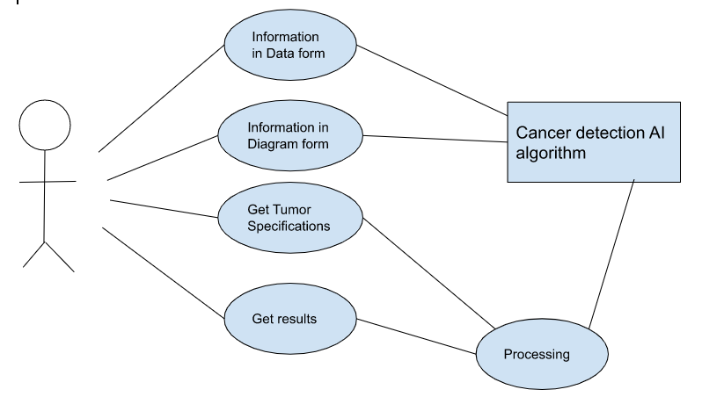
Use Case Diagram
Tumor Detection Using AI.

Slide 16
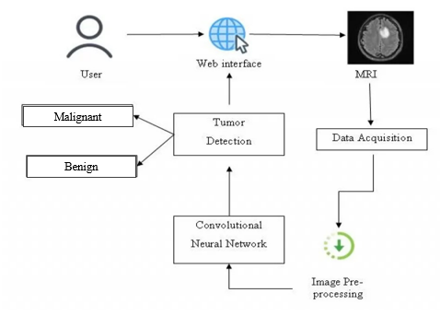
Activity Diagram
Tumor Detection Using AI.

Slide 17

Tumor Detection Using AI.

